Slide 1
Exploratory Data Analysis

Slide 2
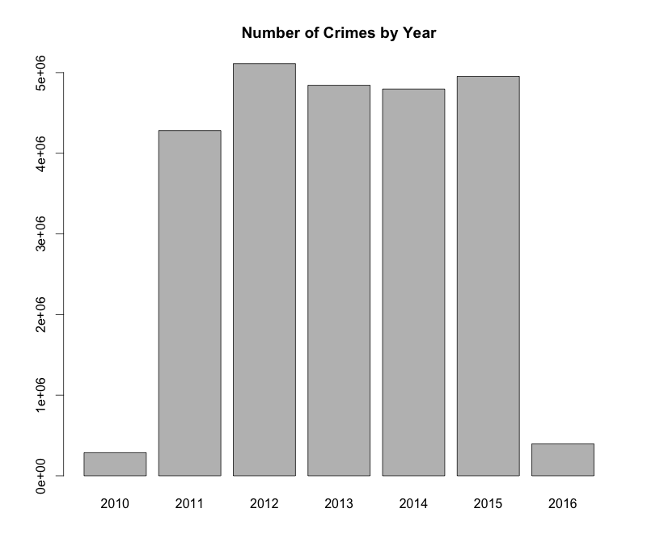
Crime Data
Total incidents: 24668162

Slide 3
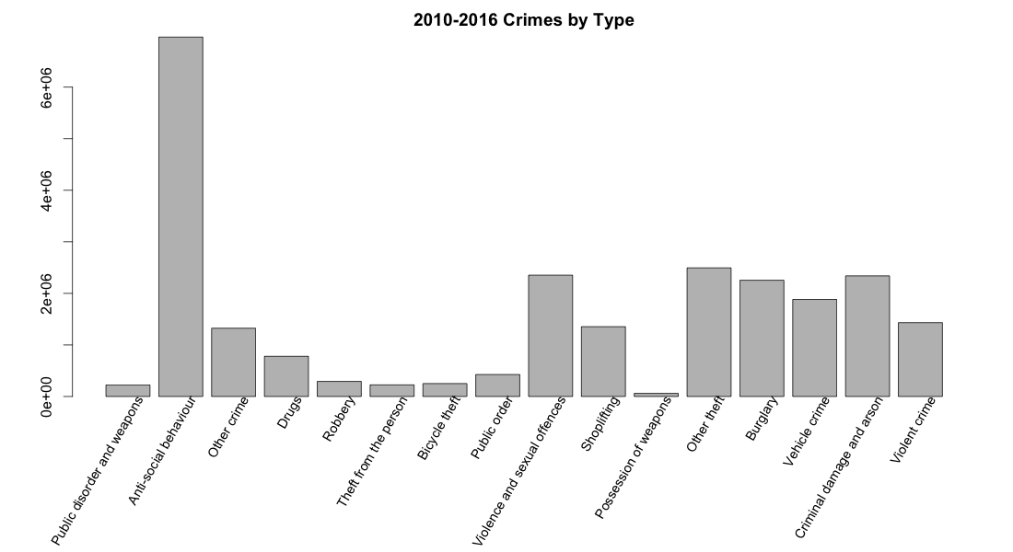
Crime Data

Slide 4
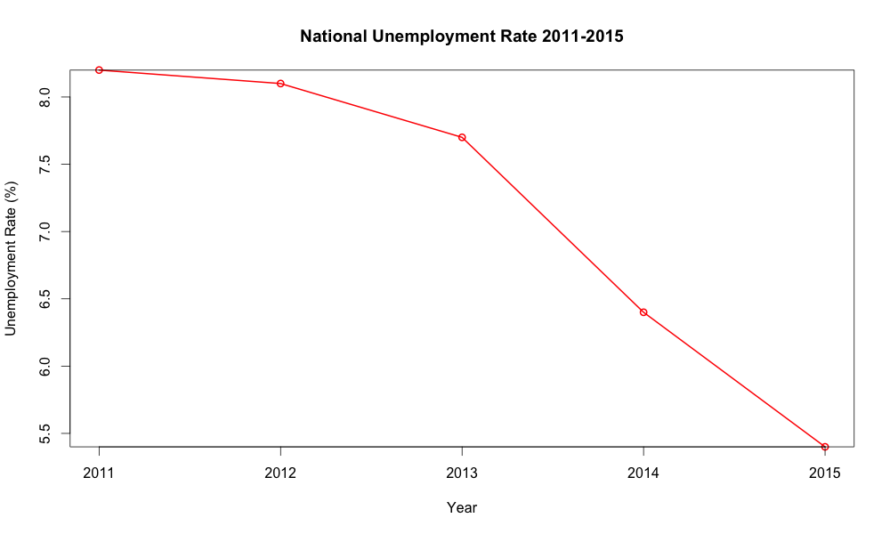
Unemployment Data
Year-district observations: 1905
• 120 NAs

Slide 5
Shapefiles
Kensington and Chelsea:
[[523042.5995562461, 182738.30144709907], [523036.5006122405, 182711.5996230743], [523191.1000363843, 182743.30061510392], [523317.5005485022, 182719.2017990814], [523713.20077287056, 182585.8995269572], [523850.4003889982, 182510.00064688642], [523885.30035703094, 182376.40141476202], [524084.3004212163, 182397.59821478184], [524459.100805565, 182336.8995907253], [524558.7974456579, 182283.70279067568], [524705.2007737944, 182033.60103044286], [524862.7022139409, 181957.7021503721], [524938.0010300113, 181733.50144616328], [524796.2999098792, 181750.99751017964], [524720.898693809, 181718.39744614926], [524886.7006779637, 181408.29338186048], [524937.599622011, 181429.30176588008], [524996.3997500658, 181305.00045376434], [525053.799046119, 181051.00134952762], [525339.4008383851, 181111.5013175842], [525394.7009344364, 180854.79885334498], [525418.3000384585, 180748.99917324656], [525493.0991425284, 180757.19936525403], [525556.8021825876, 180542.30067705386], [525848.0994628586, 180584.10035709292], [526126.1994311179, 179657.9005482304], [526399.4005833722, 179627.7027882021], [526462.7001674313, 179219.49952382199], [526878.2004558181, 179279.10246787756], [527233.600136149, 179377.0009639687], [527289.1009362007, 179298.20211589523], [527414.2009683175, 179406.1030439958], [527436.399240338, 179346.00243593985], [527633.6994645216, 179528.49766810983], [527739.40288862, 179675.50106024672], [527914.2979927829, 179753.3987883192], [527965.2010328306, 179395.0008359854], [528096.1993049525, 179230.60173183237], [528153.600649006, 178959.8008355801], [528106.9984089627, 178895.19872351992], [528178.1008730286, 178826.0008994555], [528112.3006809677, 178751.5028513861], [528197.1001690465, 178615.80237125978], [528128.8997209829, 178557.1005472052], [528138.3000409917, 178512.80025916384], [528176.2003290269, 178402.30041906098], [528130.4009049844, 178351.89913901407], [528534.4999773607, 177971.1001626593], [528563.2006493874, 177801.30253050127], [527393.2007762978, 177529.80326624843], [527392.5003602973, 177529.60256224824], [527107.2999760315, 177444.9996821694], [526939.8001998754, 177357.2019220877], [526811.6998477562, 177248.80128198676], [526640.4993355966, 176973.50092973025], [526473.4009674413, 177002.19955375697], [526321.3001032996, 176931.00083369063], [526251.9998792352, 176933.70214569313], [526112.6990151054, 177077.10310582677], [526027.6005190259, 177216.20121795638], [525904.4010309114, 177334.30118606635], [525723.7981507431, 177575.10093029053], [525520.2986305535, 177864.80281856027], [525351.6970303964, 178034.10483471793], [525320.2008383672, 178014.80243470008], [525189.2005182451, 178113.50169879198], [524894.3008059703, 178502.80192315462], [524930.4009020042, 178525.00019517518], [524846.6991419264, 178683.59936332284], [524536.3001656372, 178990.60275560874], [524494.099077598, 178975.5048995947], [524356.0003894691, 179167.40249977354], [524055.59974918957, 179493.10208407673], [523993.60064513166, 179662.000644234], [523845.9992369942, 179898.89894845476], [523843.69933299185, 179902.99904445861], [523773.2993329263, 180084.40269262763], [523913.3006130571, 180116.19789265702], [523897.70099704224, 180240.20019677258], [523962.70042110304, 180256.0025647874], [523916.1002290596, 180418.2000689383], [523844.10074099223, 180453.1020849708], [523816.0001329661, 180557.9002930685], [523757.9004209123, 180538.49958905042], [523770.6000689238, 180486.40256500198], [523674.10035683424, 180463.49978098064], [523600.0999727652, 180701.39750920213], [523427.5006766047, 181132.69811760378], [523142.19789233874, 181563.59731800505], [523017.49926822283, 181729.70240615983], [523124.2000683218, 181830.09946225327], [523124.2000683218, 182143.80186254554], [523084.3009322847, 182142.50138254417], [523069.00032427046, 182258.89946265263], [523060.9004842632, 182486.7988548649], [522964.3004201732, 182705.40237506852], [522978.59955618647, 182758.59917511814], [523042.5995562461, 182738.30144709907]]
Becomes…
Local Authority Districts: 326

Slide 6
